Slide 1
I-Focus
Group 10- Samuel Leong 4S1(17)
Ryan Tan 4S1(20)
Walter Kong 4O3(33)
Songyuan 4S2()
Notes:
[ REQUIRES AUDIOWIDE AND ARVO FONT ]
Good morning judges and fellow students. I am Samuel, this is …
And today I am very pleased to present to you our Cat 10 project… I-Focus.
I-Focus is a project that could possibly change the way we interact with our devices.

Slide 2
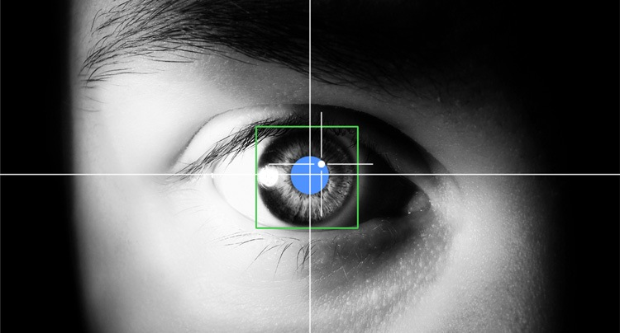
EFFICIENT.
Productive.
INTUITIVE.
Notes:
We are embarking on I-Focus - an EYE-tracking project that aims to use the latest eye-tracking technology and hopefully multi-modal input such as head gestures, in order bring you an efficient, productive and intuitive interface.

Slide 3


Objectives
Notes:
I-Focus aims to explore, through research with the Defence Science Organisation of Singapore, the most suitable input modes and their accompanying gestures.
This research, of course, will go hand in hand with applications and we will be creating a website along with a host games.. to not only demonstrate the areas in which eye-tracking can be utilised effectively, but also to be used as a tool to prove that our combination of gestures and input modes can be used by people for efficient, effective and intuitive interface control.

Slide 4

Notes:
We all use either a mouse or touchscreens to navigate around our computers

